Slide 1
Exception Handling
Exception and try-catch block | Finally Block | Error Objects
Notes:
Welcome to our lecture on string exception handling. In this lecture we will go through exception handling and try catch block, we will look at finally block, and error objects. Let’s start our lecture.

Slide 2
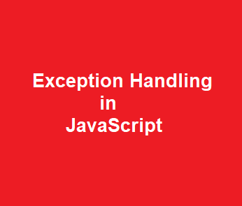
Exception and Try-Catch Block
Exception: An error that disrupts program execution, requiring handling like showing messages or shutting down.
Throw statement: Used to throw user-defined exceptions (e.g., throw "Error message").
Try-catch: Handles exceptions with a try block for risky code and a catch block for error response.
Notes:
In JavaScript, exceptions are errors that disrupt program execution and need proper handling. The throw statement allows us to create custom error messages. To handle errors, we use a try block for risky code and a catch block to respond to errors. This prevents crashes and ensures smooth program execution by handling unexpected issues effectively.

Slide 3
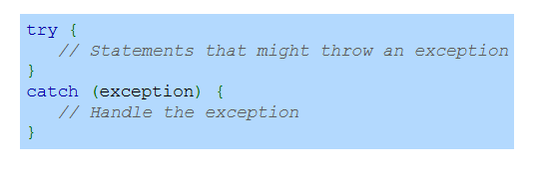
Try-Catch Block Syntax
Notes:
The try-catch block in JavaScript helps handle errors gracefully. The try block contains code that may cause an exception. If an error occurs, the catch block executes and handles it. This prevents the program from crashing and allows error handling like displaying messages or logging issues. Using try-catch ensures better stability and control in JavaScript applications.

Slide 4
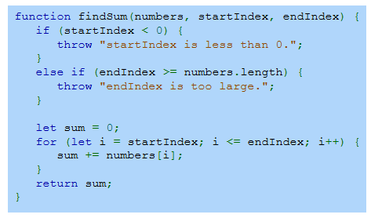
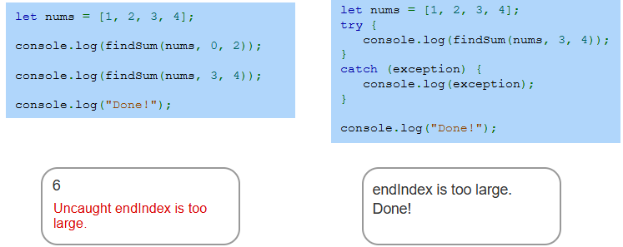
Example
Notes:
This example demonstrates exception handling in JavaScript using try-catch. The function findSum calculates the sum of elements in an array within a given range. If the startIndex is negative or endIndex exceeds the array length, an exception is thrown. Using a try block, errors are caught in the catch block, preventing crashes and ensuring smooth execution.

Slide 5
Finally Block
Finally block: Executes after try or catch, regardless of exceptions.
Used for essential operations like releasing resources or closing files.
Ensures cleanup tasks run, even if an exception occurs.
Notes:
The finally block in JavaScript executes after a try or catch block, ensuring that important tasks run regardless of whether an exception occurs. It is commonly used for resource cleanup, such as closing files or releasing memory. This guarantees that essential operations always execute, maintaining program stability and preventing resource leaks.

Slide 6
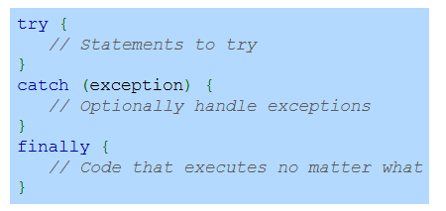
Finally Block Syntax
Notes:
The finally block in JavaScript ensures that code runs after the try and catch blocks, no matter what happens. The try block contains code that may cause an error, the catch block handles exceptions if they occur, and the finally block executes regardless of the outcome. This is useful for cleanup tasks like closing connections or freeing resources.

Slide 7
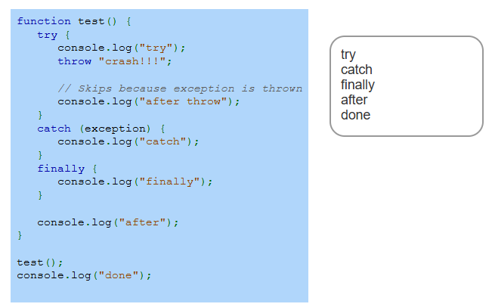
Example
Notes:
This example demonstrates how the try-catch-finally block works. The function starts by executing the try block, where an error is thrown. The catch block handles the error, preventing the program from crashing. The finally block executes regardless of the error, ensuring necessary cleanup. The remaining code runs after the function completes, showing structured error handling in JavaScript.

Slide 8
Error Objects
Throw statement: Can throw any expression, typically an Error object for runtime errors.
Error object has two properties: name (error type) and message (error details).
Error constructor accepts a message (e.g., new Error("My error message")).
Notes:
In JavaScript, the throw statement allows us to generate errors manually, usually using an Error object. The Error object has two key properties: name, which specifies the error type, and message, which provides error details. We can create custom errors using the Error constructor, allowing better debugging and handling of runtime issues in our programs.

Slide 9
Error Objects
JavaScript defines several other Error constructors, including:
RangeError - Thrown when a numeric variable or parameter is outside the valid range.
InternalError - Thrown when an internal error occurs in the JavaScript interpreter.
TypeError - Thrown when a variable or parameter is not the expected data type.
Notes:
JavaScript provides different error constructors to handle specific issues. A RangeError occurs when a number is outside an allowed range. An InternalError happens when the JavaScript engine encounters an internal problem. A TypeError is thrown when a variable or parameter is not of the expected data type. These error types help identify and manage different kinds of runtime problems effectively.

Slide 10
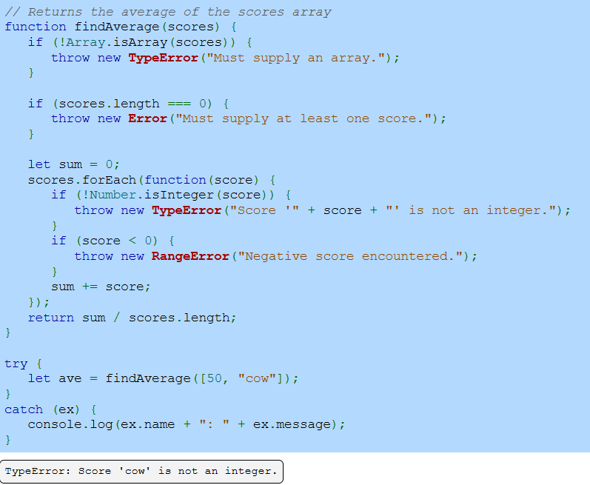
Example
Notes:
This example demonstrates error handling in JavaScript using different error types. The function find Average checks if the input is an array, contains at least one value, and has only valid integers. It throws a Type Error for non-array inputs, an Error for empty arrays, and a Range Error for negative numbers. The try-catch block catches errors, preventing crashes and providing clear error messages. Thanks for watching the lecture.

